Slide 1




POV: your [product]
just arrived
it's here
ding dong!
Everything blue is a guide. Delete it before you download.
Notes:
Slide 1. Hook. Swap in a photo at your door (or your parcel arriving). Edit [product].

Slide 2


[still waiting
for yours?]
[it's on the way]
Notes:
Slide 2. Second hook: Instagram often shows a carousel starting on slide 2, so this one works as a cover on its own. No photo needed. Edit both [bracket] lines.

Slide 3
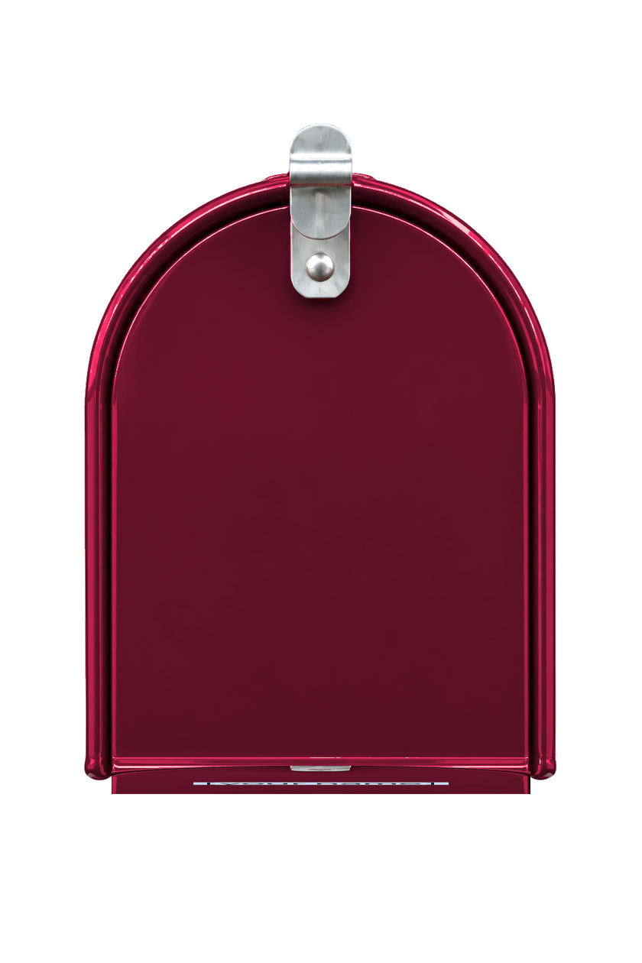

[out for delivery...]
Notes:
Slide 3. Swap in a photo of your parcel on its way (packing, the courier, a tracking screenshot).

Slide 4
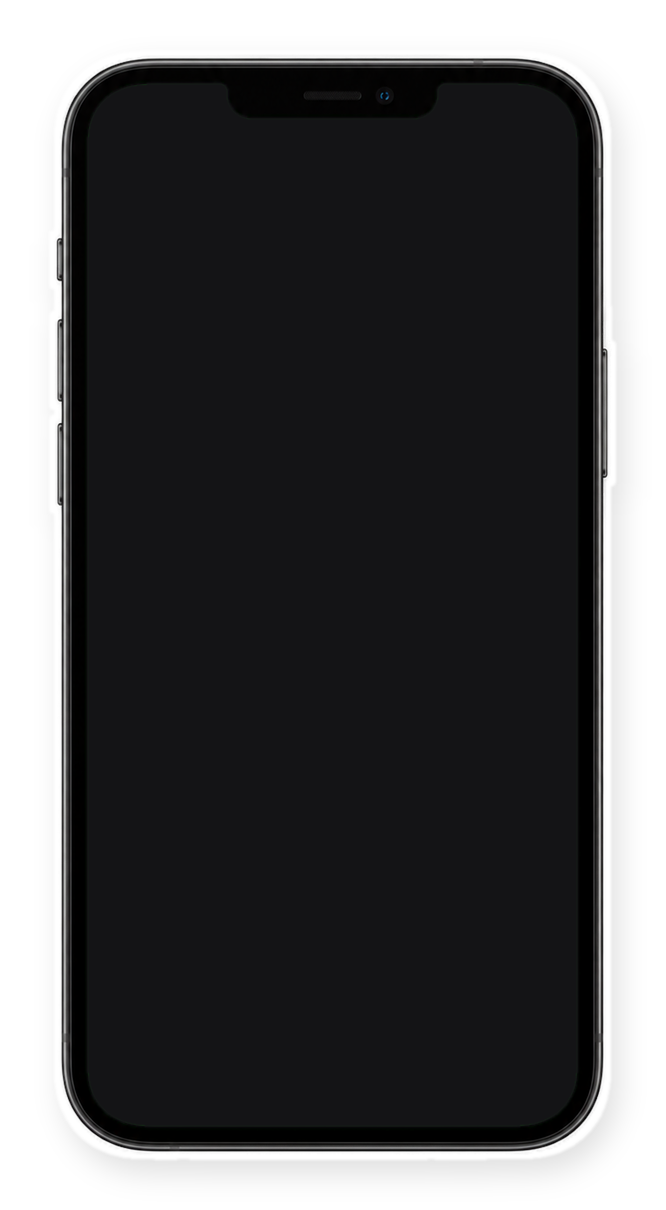

[delivered!]
Notes:
Slide 4. Swap in a screenshot of your delivery or order message for the phone screen.

Slide 5

the wait
is over
Notes:
Slide 5. No photo. These built-in words stay as they are.

Slide 6



[what's inside?]
Notes:
Slide 6. Swap in a photo of the unboxing. Edit the line.

Slide 7


[packed with
love + a little
surprise]
Notes:
Slide 7. Swap in a photo of your product in use. Edit the tag.

Slide 8



get yours
comment "[KEYWORD]"
Notes:
Slide 8. Swap in a photo of your product. Type your keyword. Caption to start from (CTA in the first two sentences, 3 hashtags): Comment [KEYWORD] and I will send you [the link]. [One line of real context: who it helps or how you use it.] #[tag] #[tag] #[tag]

